Slide 1
DEMAND & INVENTORY INTELLIGENCE
FORESIGHT
AI-driven Demand Forecasting and Inventory Optimization
NorthBay Living
Project by : - DLS Nadavi Employee ID : - ZIDIOqAD8AD Position :- Data Science & Analytics Intern Company :- Zidio Development

Slide 2
Business Problem
Retail businesses face persistent inventory challenges
!
Stockouts
$
Overstock
Popular SKUs run out, causing lost sales and disappointed customers.
Excess inventory ties up working capital that could be used elsewhere.
?
Unpredictable Demand
M
Manual Decisions
SKU-level demand is difficult to forecast, especially with seasonality.
Reorder and clearance calls rely on gut feel rather than data.
The result: lost revenue on the shelf, cash locked in slow-moving stock, and decisions made on instinct instead of evidence.

Slide 3
Solution Overview
An end-to-end pipeline from raw sales data to actionable insight
1
2
3
4
5
6
Historical Sales Data
→
Data Cleaning
→
Feature Engineering
→
XGBoost Demand
Forecast Model
→
Inventory Risk Engine
→
Streamlit Dashboard
Raw transactions are cleaned and enriched, then modeled with XGBoost to forecast demand; the risk engine flags stockouts and overstock, surfaced through a live dashboard.

Slide 4
Data & Modeling
D
Data
M
Model
Inputs used to train and evaluate the forecasting model
XGBoost Regressor
Historical transaction records
Line-level sales history across stores and time periods
Gradient-boosted decision trees trained on engineered demand features
Product information
SKU attributes, category, and product hierarchy
Sales quantities
B
Baseline
Units sold per SKU per period, the forecast target
Revenue
Sales value used to size business impact
Seasonal Naive Forecast
Pricing
List and effective price, a key demand driver
Repeats demand from the same period in the prior season

Slide 5
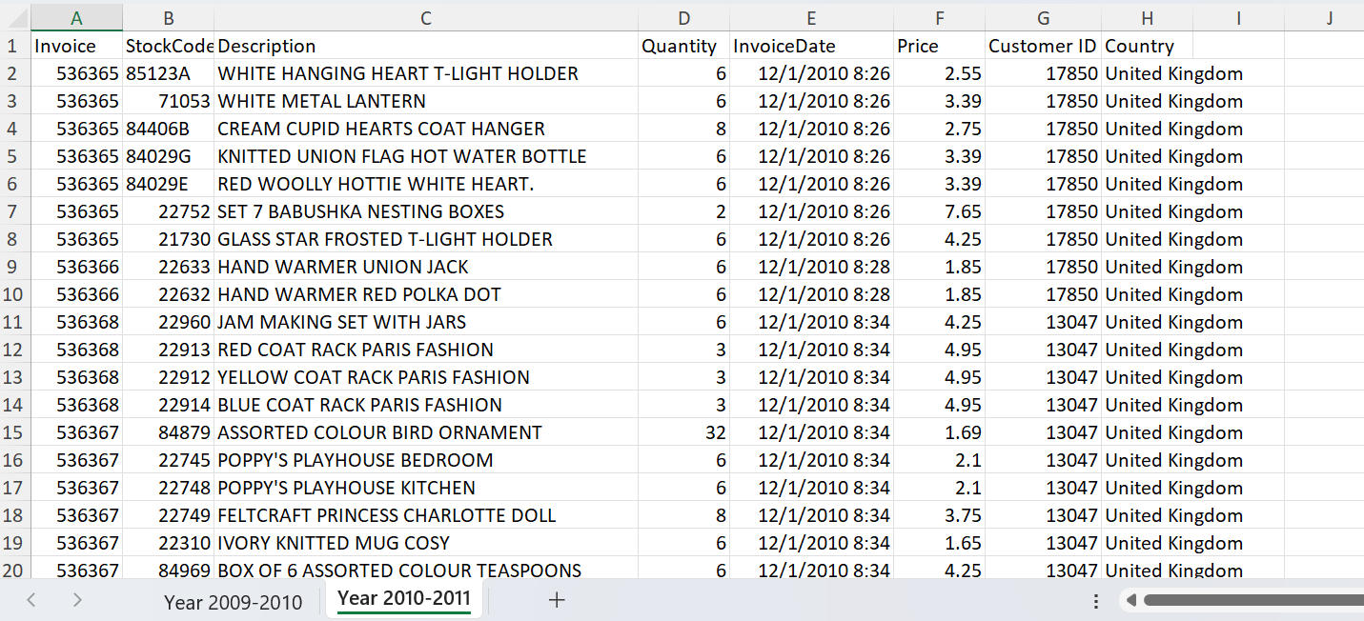
Data & Modeling
Used Dataset - https://www.kaggle.com/datasets/cgrymn/online-retail-ii-uci-dataset?utm_source=chatgpt.com

Slide 6
Model Performance
XGBoost sharply outperforms the seasonal naive baseline
Model | WAPE | RMSE
XGBoost | 20.15% | 43.72
Baseline | 86.48% | 157.14
The forecasting model improved accuracy significantly compared with the baseline.
WAPE (Weighted Absolute Percentage Error) measures average forecast error as a share of total demand. RMSE (Root Mean Squared Error) penalizes larger misses more heavily — both are lower-is-better.

Slide 7
Business Impact
Live dashboard metrics across the current SKU catalog
3,922
136
3,806
$91,424.46
TOTAL SKUS
STOCKOUT RISK
OVERSTOCK
SALES AT RISK
3.5% of SKUs are at stockout risk, while 97% carry overstock — highlighting where reorder and clearance actions should focus first.

Slide 8
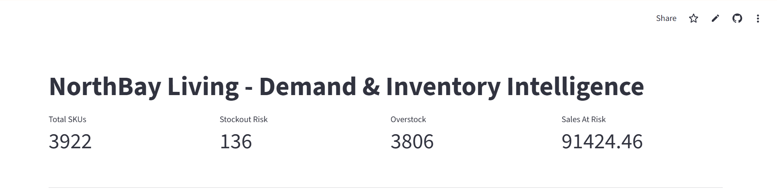
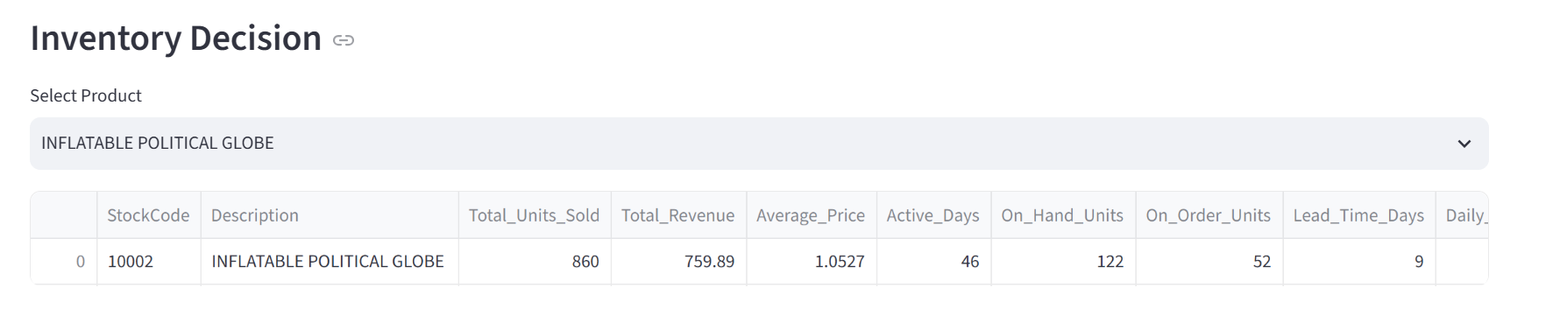
Dashboard Demo
Streamlit dashboard

Slide 9
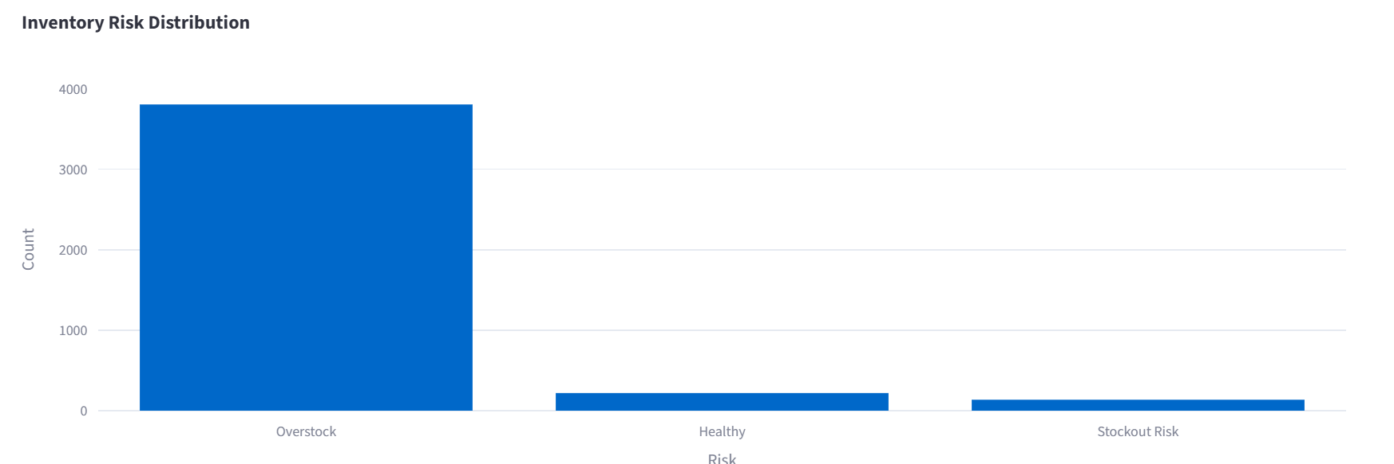
Dashboard Demo
Streamlit dashboard

Slide 10
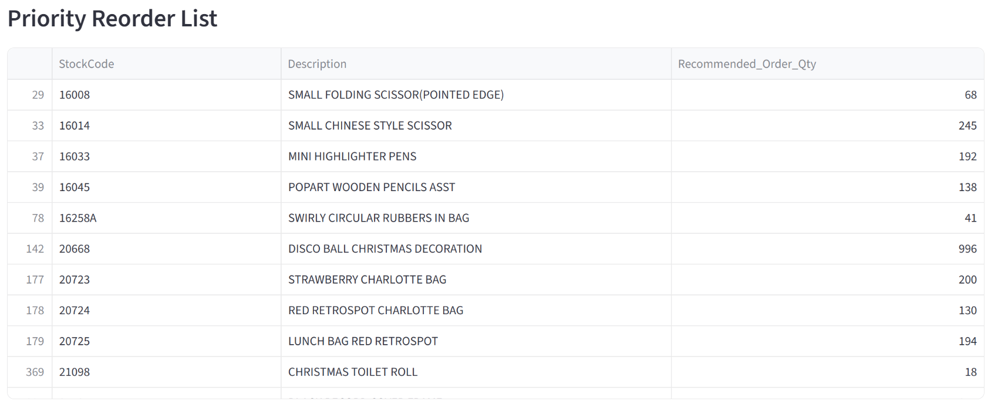
Dashboard Demo
Streamlit dashboard

Slide 11
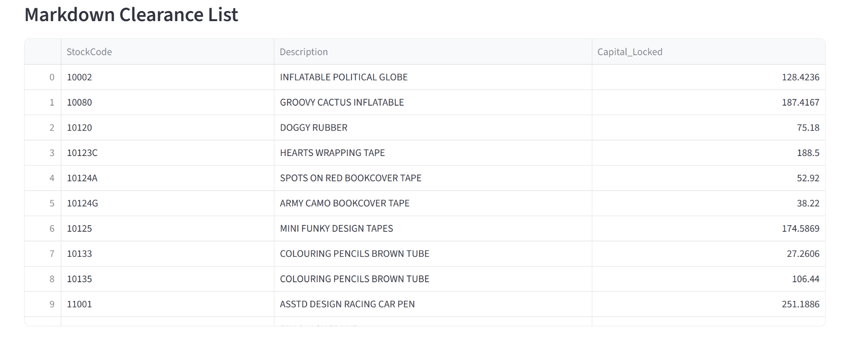
Dashboard Demo
Streamlit dashboard

Slide 12
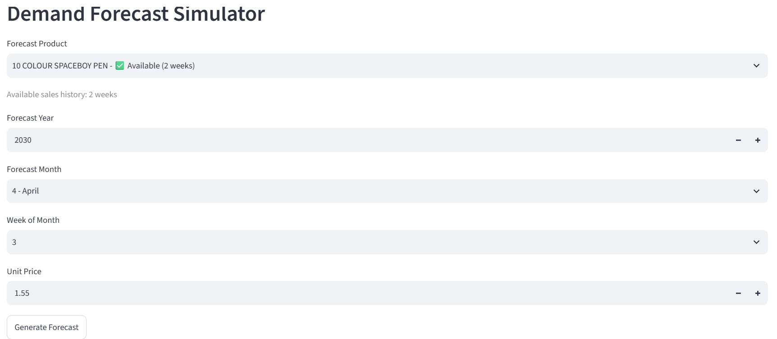
Dashboard Demo
Streamlit dashboard

Slide 13
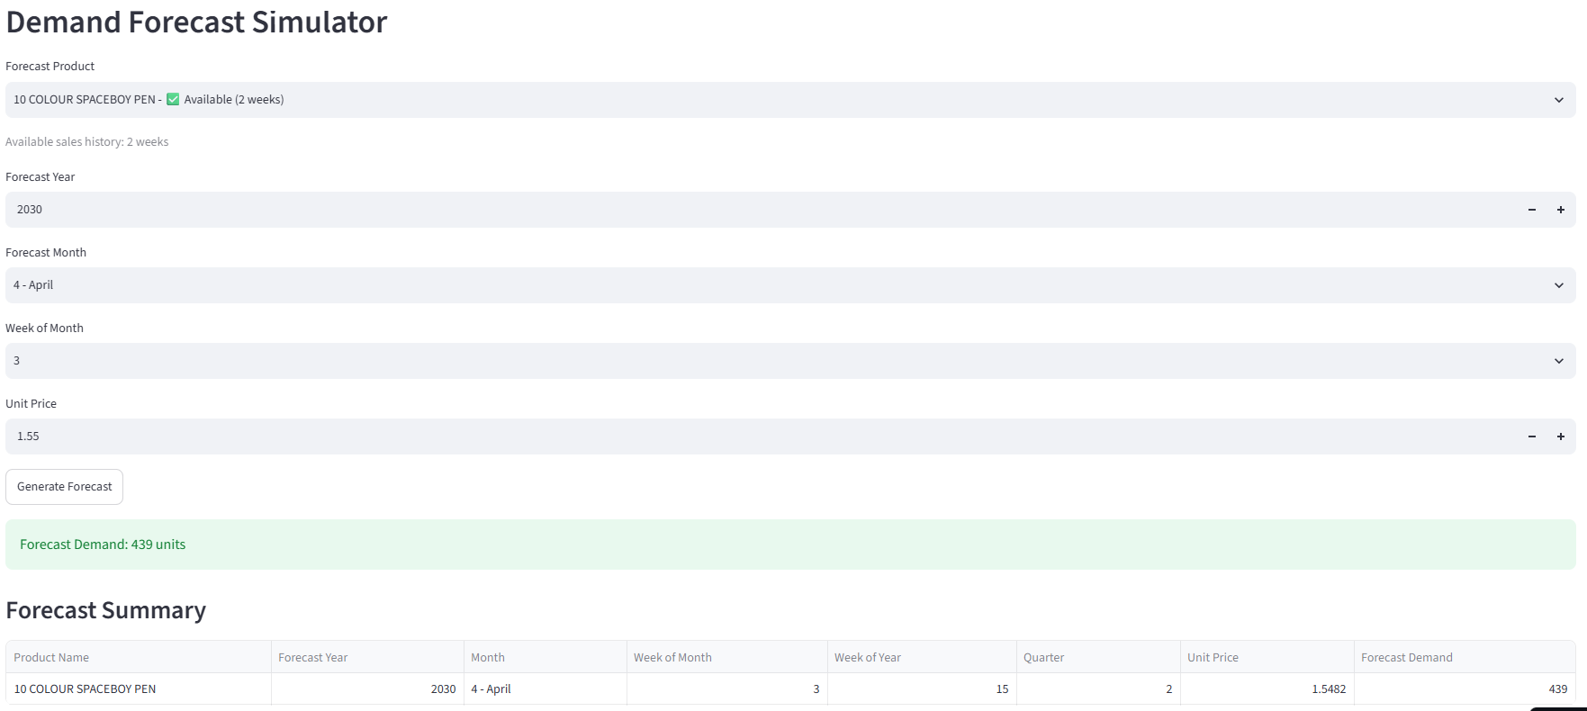
Dashboard Demo – Forecasting Example
Streamlit dashboard

Slide 14
Recommendations
Turning forecasts into inventory action
1
Prioritize Reorders
Act first on products flagged with stockout risk to protect sales.
2
Reduce Excess Inventory
Run clearance actions on overstocked SKUs to free up capital.
3
Plan with Forecasts
Use demand forecasts as the basis for ongoing inventory planning.
4
Monitor Performance
Track WAPE and RMSE regularly to catch model drift early.

Slide 15
References
GitHub Repository Link : https://github.com/DLS-Nadavi/Zidio-Development_Project-01_foresight-demand-inventory-intelligence.git Streamlit App Link : https://zidio-developmentproject-01foresight-demand-inventory-intellig.streamlit.app/ Used Dataset - https://www.kaggle.com/datasets/cgrymn/online-retail-ii-uci-dataset?utm_source=chatgpt.com

Slide 16
Thank You !

